Slide 1



OSG MidScale Collaborations
An Update on the Collaboration Support Area
Pascal Paschos
Enrico Fermi Institute
University of Chicago
Open Science Grid Area Coordinators Call
Feb 2021

Slide 2






Objective of this presentation
Progress on GaTech CC* Pace Cluster
XENON data management challenges
FTS service for XENON & IGWN
Planning GridFTP migration for Collaborations
Contributions to OSG Collaboration Support from:
Lincoln Bryant: SLATE/UC
Judith Stephen - Rucio services, storage, systems
Mats Rynge (Pegasus- XENON/VERITAS/Snowmass21 )
Edgar Fajardo, Derek Weitzel, Brian Lin - OSG Infrastructure
James Clark - IGWN data management

Slide 3
GaTech CC* PACE Cluster
Last Spring the UC group agreed to help Gatech PACE to bring their cluster online and integrate with OSG
A number of cluster management issues were first solved (HTCondor) and two admins trained
Leveraged SLATE to facilitate hosted CE deployment: Georgia_Tech_PACE_CE_2
OSG VO support: added in December
Moved to collaboration support Jan/21 to help deploy LIGO and Icecube VOs
Coordinated with the PACE team on user support documentation

Slide 4
GaTech CC* Pace Cluster
New StashCache node - osg-gftp2.pace.gatech.edu deployed July 2020 with authenticated access to Ligo frame files
Rest of the cluster and OSG services deployed with the assistance of the UChicago team
Local HTCondor batch system
SLATE-based HostedCE, inside of GATech firewall
deployed via OSG image
no inbound SSH required, only HTCondor traffic from glidein factories and K8S traffic from UChicago
SLATE-based Squid service
deployed via OSG image
All working well.
Will need help from OSG and/or HTCondor team to properly configure fairshare after enabling access to LIGO/Icecube

Slide 5
GaTech CC* Pace Cluster Next Steps
Admins need to create Ligo, Icecube service accounts and then we will reinstall CE via Slate to enable VO jobs other than OSG
Job submissions to LIGO/OSG pools from osg-login2.pace.gatech.edu
Failing at the moment. This is currently in progress and started ticket in helpdesk
Validate local jobs for Pace LIGO users. Local team will validate this step after grid jobs
Final step is some assistance in setting up the fairshare on the resource across different VOs per the requirements of their grant
The name on the CE might change to reflect the multi-VO

Slide 6
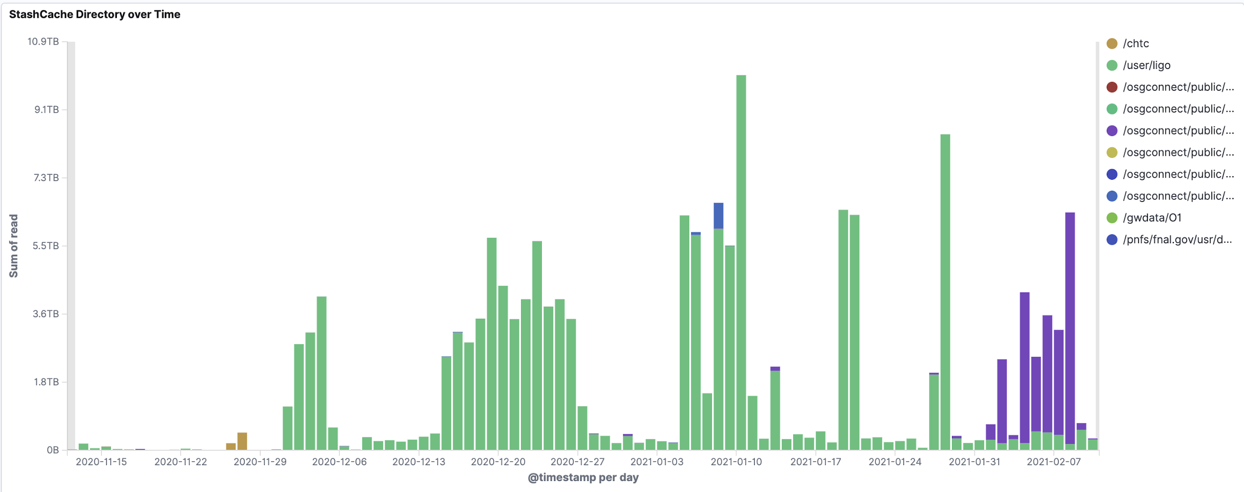
PACE Stashcache read access
osg-gftp2.pace.gatech.edu
Gracc Kibana Link

Slide 7
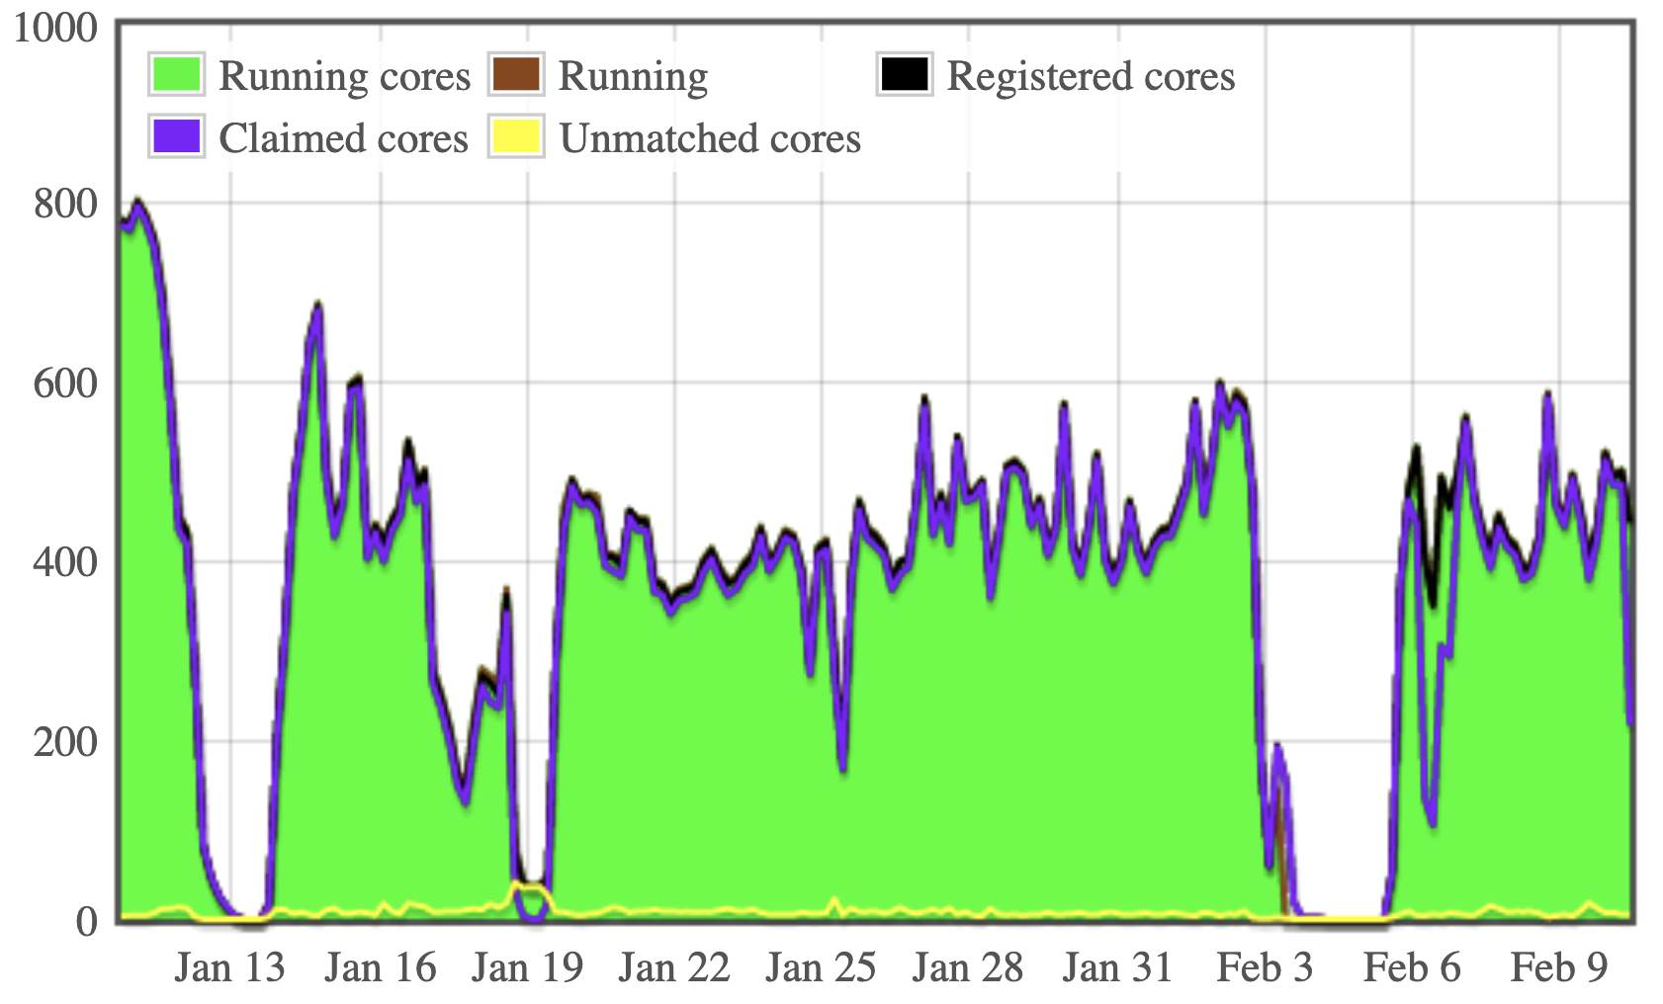
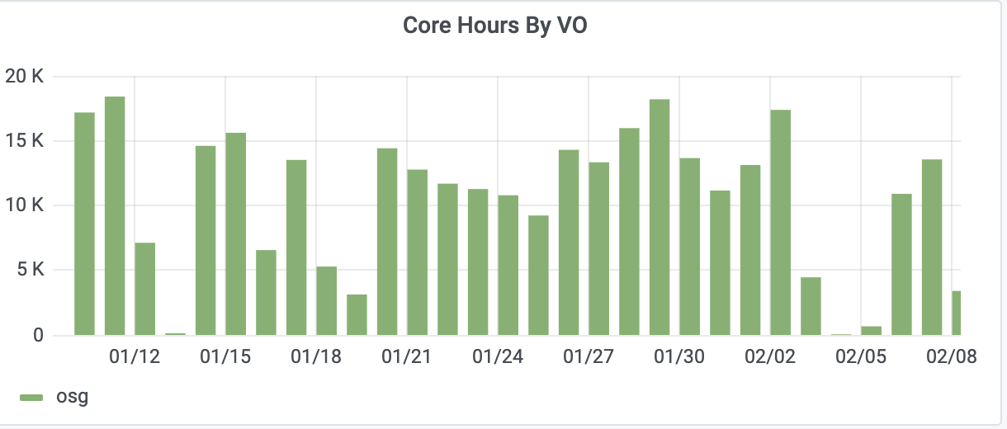
Jobs on the resource
Glidein jobs to OSG_US_GATech_osg-sched2
Gracc Link
OSG factory link

Slide 8
XENON data Management
XENON data management relies on services deployed at UChicago with an international storage footprint at 3 PB at present
Services at the US
UChicago (Grid): 1PB dCache storage, Access to Stash storage, Rucio & FTS servers, OSG Submit node, MongoDB mirror
UChicago (HPC): 270 TB gpfs storage, worker nodes for analysis
Rice Univ: MongoDB mirror, stakeholder in CC*/GPU cluster
Services in Europe:
Instrument and data ingestion infrastructure (Italy)
The rest of storage and local compute clusters
Limits of storage availability, data growth for nT and augmented MC production pipelines necessitated adjusting their data management process

Slide 9
XENON data Management changes
Increase of tape allocation at CNAF as they are near capacity there ( from 1 PB to 3 PB). Limit to be adjusted in Rucio.
Reorganization of namespace on tape to reduce vulnerability due to complicated directory structure. This requires adding an a custom lfn2pfn algorithm and a new CNAF RSE.
700 TB of XENON1T data to be transferred from the US to Europe to free space for OSG production jobs.
New rules for data replication to CC2INP3 and UC (primary disk storage locations) from LNGS
New Rucio account for MC workflows and adjustments in software stack for data uploads (adMix) and processing (strax)

Slide 10
Namespace reorganization at CNAF
deterministic
30k top dirs
deterministic
~70 top dirs with 15k sets in each one
XENONnT data
CNAF tape
XENON1T data
RSE-1
RSE-2
Rucio Tape->Tape Rule
RSE-3
Non-deterministic
Flat structure - 7 top dirs but 150k sets projected in each
CNAF tape buffer
On completion we will delete RSE-2 and rename RSE-3
The process will be followed for XENON1T data at a later time

Slide 11
XENON data management next steps
Continue to work with XENON to ensure that dCache is freed up for XENONnT data and OSG production jobs
Due to the large volume of data transfers and deletions there is some strain on Rucio
The Rucio conveyor-poller gets stuck and needs a restart
Deletions of data in Rucio don’t automatically delete data on disk. Running additional Rucio Reaper processes to help mitigate the issue
XENON’s Monte Carlo team will also be computing on OSG for XENONnT besides processing campaigns of experimental data. Will continue to work with their team to find the right balance on storage and jobs submitted to the grid
Continue to contribute in ensuring maturity of the software stack for nT (Mats)

Slide 12
FTS Service
Hosted at UChicago ATLAS Midwest Tier2 Center (MWT2)
Service url: fts.mwt2.org
Used by XENON and IceCube
Managed by Judith Stephen (UChicago). Problems, issues: send email to help@opensciencegrid.org
Monitoring:
Ganglia: http://gmetad-kvm.mwt2.org/?c=MWT2%20KVM&h=fts.mwt2.org&
Ftsmon: https://fts.mwt2.org:8449/fts3/ftsmon/
check_mk -> notifications to admin team
OpenStack VM: EL7 16 GB disk, 10 GB memory, 4 VCPUs, default port: 8443. 8449 for monitoring

Slide 13
FTS3 service for XENON
The FTS service is critical for the XENON data management
Volume at times exceeds 100k transfers for XENON due to:
Increased volume of datatsets from the instrument. Local capacity at LNGS is limited so it is important to get the data out in real time
Transfers of XENON1T data from the US and Europe to their final resting places (CC2INP3 & CNAF)
Operationally, the service is meeting demand with occasional challenges from the large volume of transfers
Log files need to be automatically purged periodically to prevent filling up local disk
The FTS DB is growing in size requiring extending the disk

Slide 14
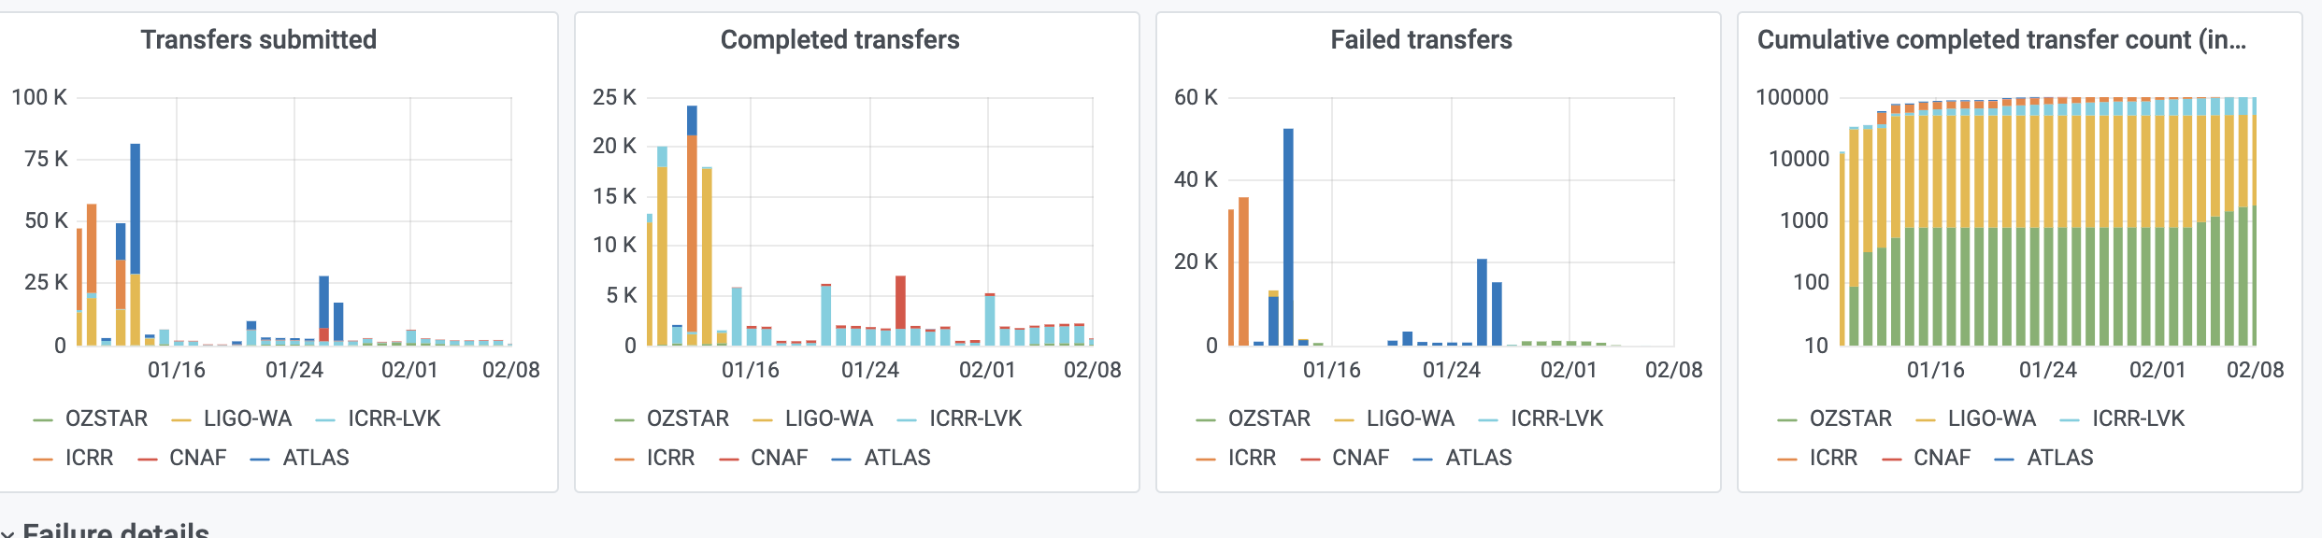
FTS3 service for IGWN
FTS3 service for IGWN supports LIGO’s data management plan using Rucio. Rucio server hosted in Nautilus at present
A slack channel dedicated to ligo-rucio fts provides direct support
Bursty transfers from CIT to 3 international sites
Impacted by the cert/CLR revocation issue - discussed in Brian Bockleman’s talk which did not timely update in Oasis. A local install of 1.92-1.osg35.el7 fixed it.
IGWN FTS dashboard link

Slide 15
Alternatives to GridFTP
Mid-scale collaborations are not yet thinking about GridFTP transition
Collabs dedicate very little staff time to data management and access
GridFTP working okay, resistance to changing something that works
Will be starting discussions with SPT, XENON et al
Some choices:
HTTP is a clear leader for data federations
LHC experiments e.g. migrating to WebDAV-based access
XRootD/StashCache
Workloads typically not cache friendly, but could leverage stashcp work (incl. authenticated StashCache)

Slide 16
Development of a SLATE Rucio service
Several mid-scale collaborations rely on the UChicago team to support data management
Xenon already uses a Rucio service running at UChicago, but its circa-2016 setup lags behind what is recommended for current rucio installations (VM installation vs. Docker/Kubernetes)
SPT is evaluating a more advanced data management solution
Smaller collaborations could also make use of the new multi-VO rucio
See Eli Chadwick’s talk at 3rd Rucio Community Workshop here
SLATE app development
Existing Rucio SLATE app in the incubator is stale, needs to be updated
Starting anew with the rucio team-provided helm charts
Some changes will need to be made to conform with the SLATE permissions model

Slide 17
Questions

